Slide 1

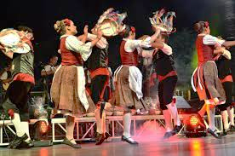





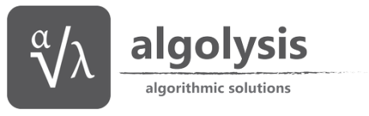
SCHEDAR Safeguarding the Cultural HEritage of Dance through Augmented Reality

Slide 2
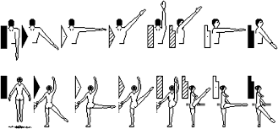
Context
Dance is part of Intangible Cultural Heritage (ICH)
Widespread availability of cultural content in digitized forms is a critical necessity for the preservation of the continuity of our heritage and identity as Europeans.
Tangible Heritage has benefit from technological innovations ≠ dance
Traditionnally dance modelled as text or images ➔ difficult to disseminate for the large public audience
Labanotation

Slide 3
Scientific Challenges
Capture, preserve and subsequently re-create ICH in dance
Technology-assisted modeling of dance
Complexity of motion, high-dimension representation, identification of relevant parameters, meaningful assisted annotations for metadata & features extraction
Easy-to-use and cheap data acquisition
Calibrationless mocap, uncontrolled conditions, capturing shape and motion, data enhancement
Dissemination worlwide using virtual coach and “learning by doing” AR-based technology
Transfer of skills to real practice, choice of multisensory feedback

Slide 4
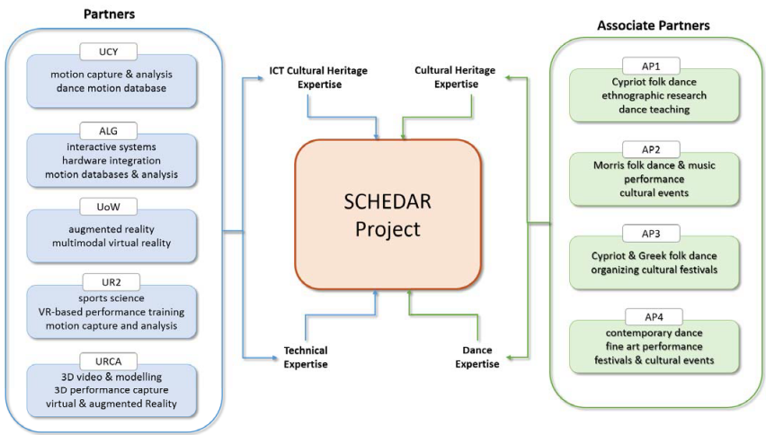
A multidisciplinary consortium

Slide 5
Proposal
Enhance cheap depth images to capture human performance on-site
Expertise in UR2 (skeleton data clean-up, multi-cameras calibration&data fusion, motion analysis/modelling)
Expertise in URCA (visual computing, creation and visualization of « rich » content)
Semi-Automatic Annotation and processing of motion data
Expertise in UCY (algorithms for analysing and processing motion captured dance sequences)
Expertise in ALG (hardware integration, motion database management)
Augmented Reality / Virtual Reality for training
Expertise in UoW (AR, multisensory VR in Cultural Heritage)
Expertise in UR2 (VR training, sports training, sports sciences)

Slide 6
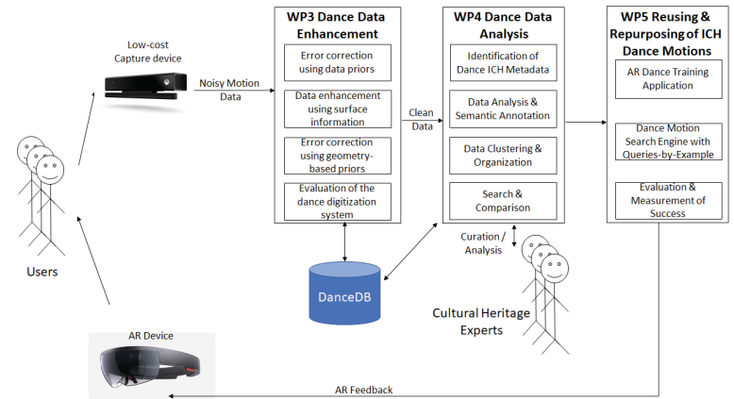
Project organization
PhD URCA
Postdoc UCY
Postdoc UoW
Enriched data
Engineer ALG
Postdoc UR2

Slide 7
Awaited impact - dissemination
Wide scientific dissemination in C&G, sports sciences, VR/AR
Integration of project outcomes in EUROPEANA repository (European digital platform for cultural heritage)
Using cheap and easy-to-use system for natural on-site performance measurement ➔ ensure large dissemination
Co-design with Sports Science dept and Associate Partners ➔ credible dissemination
AR Dance Demo at Politistiko Ergastiri Ayion Omologiton (temporary exhibition)

Slide 8
Awaited impact - exploitation
Software mocap enhancement could be out-licenced
Sports, entertainment, ergonomics (start-up company in UR2), rehabilitation
Search engine for mocap data could be out-licenced
Game developers, animators, VR/AR producers…

Slide 9
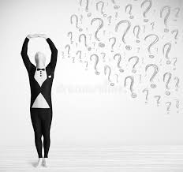
Questions? fmulton@irisa.fr

